Slide 1
Memory Organization:
Associative Memory
(Lecture 58)

Slide 2
Introduction
Memory System
If you recall, based on accessing mode we distinguished two classes of memory systems:
Address accessible Memory, and
Content addressable Memory
In the last module, we concentrated on address accessible memory. This module concentrates on the content addressable memory.

Slide 3
Associative Memory or CAM
A memory unit accessed by content is called an associative memory or content addressable memory (CAM). This type of memory is accessed simultaneously and in parallel on the basis of data content rather than by specific address or location. When a word is written in an associative memory, no address is given.
A Content Addressable Memory is defined as a collection of storage elements which are accessed in parallel on the basis of data contents rather than by specific address or location.
Each associative cell should have hardware capability to store and search its contents against the data which is broadcast by the control unit, and indicate a match or mismatch by the state of a flip flop.
Read, write, and search are the basic operations in an associative memory.
The memory is capable of finding an empty unused location to store the word. When a word is to be read from an associative memory, the content of the word, or part of the word, is specified. The memory locates all words which match the specified content and marks them for reading.

Slide 4
Associative Memory or CAM(Cont..)
Due of its organization, this memory is uniquely suited to do parallel searches by data association. Moreover, searches can be done on an entire word or on a specific field within a word.
The time required to find an item stored in memory can be reduced considerably if stored data can be identified for access by the content of the data itself rather than by address.
Associative memories are used in applications where the search time is very critical and must be very short.
Associative memory is expensive than a random access memory because each cell must have storage capability as well as logic circuits for matching its content with an external argument.
However, there are areas within high-performance architectures, such as cache and virtual memory management, where content addressable memories play a critical role, and their cost can easily be justified

Slide 5
Hardware Organization
Associative memories are used in applications where the search time is very critical and must be very short.
Associative memory is expensive than a random access memory because each cell must have storage capability as well as logic circuits for matching its content with an external argument.
However, there are areas within high-performance architectures, such as cache and virtual memory management, where content addressable memories play a critical role, and their cost can easily be justified.
The block diagram of an associative memory is shown in next slide. It consists of a memory array and logic for m words with n bits per word. The argument register (Comparand /data Register ), A and key register (Mask Register), K each have n bits, one for each bit of a word. The match register (Tag register), M has m bits, one for each memory word. Each word in memory is compared in parallel with the content of the argument register.
The words that match the bits of the argument register set a corresponding bit in the match register. After the matching process, those bits in the match register that have been set indicate the fact that their corresponding words have been matched.

Slide 6
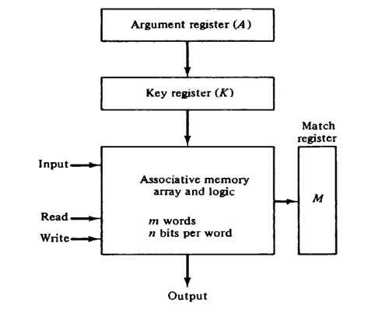
Hardware Organization (Cont..)
The key register provides a mask for choosing a particular field or key in the argument word. The entire argument is compared with each memory word if the key register contains all l' s. Otherwise, only those bits in the argument that have l's in their corresponding position of the key register are compared.
Thus the key provides a mask or identifying piece of information which specifies how the reference to memory is made.
Block Diagram of Associative memory

Slide 7
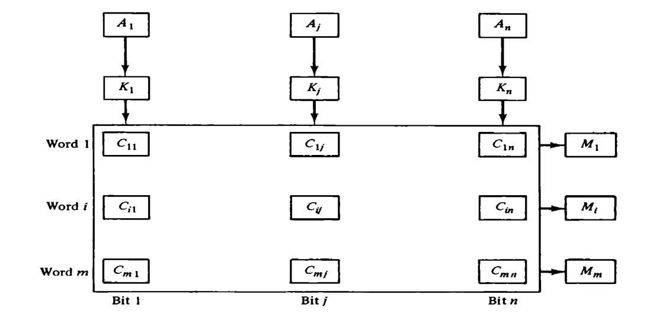
Hardware Organization (Cont..)
The relation between the memory array and external registers in an associative memory is shown in below.
The cells in the array are marked by the letter C with two subscripts. The first subscript gives the word number and the second specifies the bit position in the word. Thus cell Cij is the cell for bit j in word i.
A bit Aj in the argument register is compared with all the bits in column j of the array provided that Kj = 1. This is done for all columns j = 1, 2, . . . , n. If a match occurs between all the unmasked bits of the argument and the bits in word i, the corresponding bit Mi in the match register is set to 1.
If one or more unmasked bits of the argument and the word do not match, M1 is cleared to 0.
Associative Memory of m Words (each of n cell size)

Slide 8
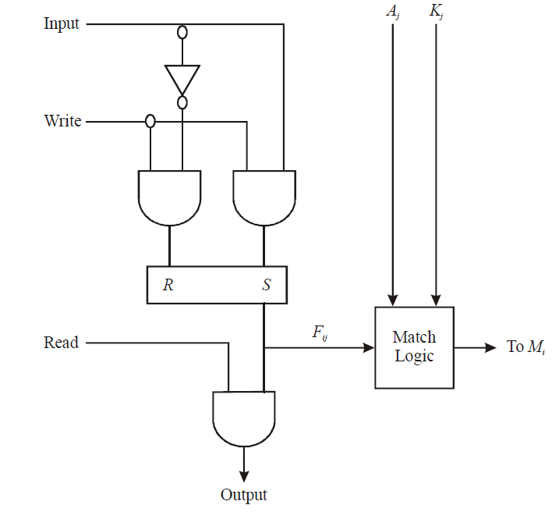
Hardware Organization (Cont..)
The internal organization of a typical cell Cij is shown below. It consists of a flip-flop storage element Fij and the circuits for reading, writing, and matching the cell. The input bit is transferred into the storage cell during a write operation. The bit stored is read out during a read operation. The match logic compares the content of the storage cell with the corresponding unmasked bit of the argument and provides an output for the decision logic that sets the bit in Mi.
One cell of associative memory

Slide 9
How Does Associative Memory Work?
Data-Tag Association: In associative memory, each data word is associated with a tag or key. This tag represents some characteristic or attribute of the data word. For example, in a network routing application, the tag could be an IP address, and the associated data could be a port number.
Parallel Comparison: When a search operation is initiated, the search key (which typically matches the format of the tags stored in the memory) is presented to the memory array. Unlike traditional memory structures where data is accessed sequentially or by a specific address, associative memory performs parallel comparisons of the search key with all the stored tags simultaneously.
Match Detection: As the search key is compared in parallel with the stored tags, the memory system detects any matches between the search key and the tags stored in the memory array. If a match is found, it indicates that the corresponding data word is associated with the matching tag.
Data Retrieval: Upon detecting a match, the associative memory retrieves the data associated with the matching tag. This data can then be provided as the output of the search operation.
Multiple Matches Handling: In scenarios where multiple entries in the memory array match the search key, the associative memory may employ mechanisms to handle multiple matches. This could involve selecting the highest-priority match, providing all matching entries, or using other predefined criteria for selection.

Slide 10
Numerical Problem
To illustrate with a numerical example, suppose that the argument register A and the key register K have the bit configuration shown below. Only the three leftmost bits of A are compared with memory words because K has 1's in these positions.
A 101111100
K 111000000 (As k has 1's in these positions so consider 3 leftmost bits)
Word 1 100111100 no match
Word 2 101000001 match
Word 2 matches the unmasked argument field because the three leftmost bits of the argument and the word are equal.

Slide 11
Numerical Problem (Cont..)
Let as consider an example where the argument register A and the key register have bit configuration as:
A 10101010
K 00001111
Now these two registers set the search pattern to 1010 in last four bits. For all words that contain the pattern 1010 in last four bits will set the match bit. Lets us consider the following three words and try to find their match status for the above pattern.
Word1 10101111 no match
Word2 11111010 match found
Word3 10101011 no match
Here only word 2 sets match status. Thus, in this case when the CAM performs a search, the logic associated with pattern, i.e., the presence of 1010 pattern in the last four bit (selected pattern) will be compared with each word. The tag bit for the corresponding word will be set to one if the match is found. Thus, tag bit for word 2 will be set. At the end of this process, all matching words may be identified by their tag bits.

Slide 12
Key operations (Read and Write)
The hardware organization of associative memory involves several key operations:
Read Operation: If more than one word in memory matches the unmasked argument field, all the matched words will have 1's in the corresponding bit position of the match register. It is then necessary to scan the bits of the match register one at a time.
The matched words are read in sequence by applying a read signal to each word line whose corresponding M, bit is a 1.
In most applications, the associative memory stores a table with no two identical items 'under a given key. In this case, only one word may match the unmasked argument field. By connecting output M; directly to the read line in the same word position (instead of the M register), the content of the matched word will be presented automatically at the output lines and no special read command signal is needed.
Furthermore, if we exclude words having a zero content, an all-zero output will indicate that no match occurred and that the searched item is not available in memory.

Slide 13
Key operations with Associative memory
Following are two common approaches to writing in an associative memory:
Bulk Write Operation: In scenarios where the entire memory is loaded with new information before a search operation, a bulk write operation can be employed. This approach treats the associative memory as a traditional random-access memory (RAM) during the writing phase. Each location in the memory array is addressed sequentially, and data is written into the corresponding memory cells.
Address Decoding: To simplify addressing, a decoder can be used to reduce the number of address lines required. Instead of having an address line for each word in memory (m), the decoder reduces the number of address lines to d, where m = 2^d. This enables efficient addressing of memory locations during the write operation.
Dynamic Write Operation: In scenarios where individual words need to be inserted or deleted from the memory, a dynamic write operation is employed. This approach requires additional control logic to manage the state of each word in the memory array.
Tag Register
Writing and Deleting Words
Masking:

Slide 14
Advantages and Disadvantages
Associative Memory — Advantages
Content addressability
Parallelism
In-place operations
Associative Memory — Disadvantages
Cost
Size of the basic memory cell
Long propagation delay
Input/Output operations

Slide 15
Applications of Associative memory
Here are some common applications:
Cache Memory: In computer architecture, associative memory is extensively used in cache memory systems. Cache memory stores frequently accessed data and their corresponding memory addresses from a larger main memory. Associative memory allows for fast retrieval of cached data by searching for the memory address in parallel across the cache lines.
Database Systems: Associative memory is employed in database systems for indexing and searching large datasets. It allows for quick retrieval of records based on their attributes or keys, enabling efficient querying and data retrieval operations.
Network Routing: In networking devices such as routers and switches, associative memory is used for routing tables. It facilitates fast lookup of destination IP addresses to determine the appropriate outgoing interface or next hop for packet forwarding, helping to optimize network performance.
Pattern Recognition: Associative memory is valuable in pattern recognition tasks such as facial recognition, fingerprint recognition, and handwriting recognition. It enables the system to quickly match input patterns with stored templates or models, making it useful in biometric systems, security applications, and optical character recognition (OCR) systems.
Hardware Accelerators: Associative memory is employed in hardware accelerators for tasks like regular expression matching, packet inspection, and intrusion detection in cybersecurity applications. These accelerators leverage the parallelism and speed of associative memory to perform high-throughput content-based processing. In AI, CBIR etc.

